Slide 1
Mysql Day 04
GROUPING & SORTING

Slide 2
GROUPING
Grouping in MySQL refers to the process of grouping rows together based on common values in one or more columns.
This is useful when we want to analyze data in aggregate, such as calculating summary statistics or generating reports.
We use GROUP BY clause to group data as per our requirement.
We can also group data , and then sort the groups by specific columns.
General Syntax:
SELECT column_name
FROM table_name
ORDER BY column_name;
1

Slide 3
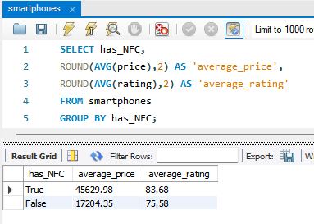
Group Smartphones by whether they have NFC , and get the average price and average rating.
In the alongside image, we can see the SQL Queries to find average price and average rating of the smartphones.
We then group all the smartphones into those having NFC and those without it, Using GROUP BY clause.
Thus, it is as simple to perform grouping in MySQL.
Always focus on the logic, and break down the complex questions into simpler query based solutions.
2

Slide 4
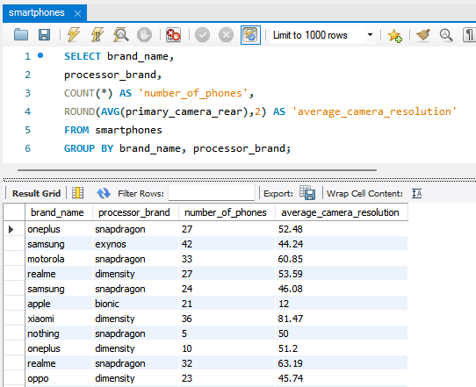
Group Smartphones by brand & processor. Get the count of models and average primary camera resolution(rear).
In the alongside image, we can see the SQL Queries to find count of the models, their average primary camera.
We then group all the smartphones by their brand name and processor brand.
Notice all the queries and statements used, including, COUNT, ROUND, AVG, AS apart from GROUP BY .
GROUP BY is a powerful tool that allows us to group and analyze data in many different ways, as per our needs.
3

Slide 5
SORTING
Sorting in MySQL refers to the process of organizing data in a particular order.
Sorting can be done in Ascending or Descending order based on a specific columns, or set of columns in a table.
Sorting is helpful when we want to present data in a specific order or when we want to find specific data within a large dataset.
The Two different ways to sorting data in MySQL is:
ORDER BY : This is the most common way to sort data in MySQL. We can specify which column(s) to sort by, and whether to sort in Ascending (ASC) or Descending Order (DESC).
GROUP BY : We have seen this earlier in this presentation. We can use GROUP BY to group data by one or more columns and then Sort the groups by a specific column.
4

Slide 6
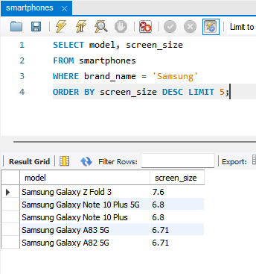
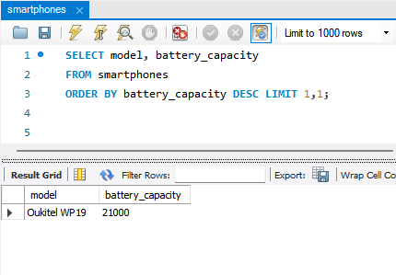
1. Find Top 5 Samsung Phones with biggest screen size.
2. Find the phone with 2nd largest battery.
In the alongside image, we can see how easily we can sort our data using ORDER BY.
Remember the use of DESC, ASC and LIMIT.
1
2
LIMIT is used to show the truncated result, that we need
We have to be thorough with the ‘Offset’ concept , used here.
5

Slide 7
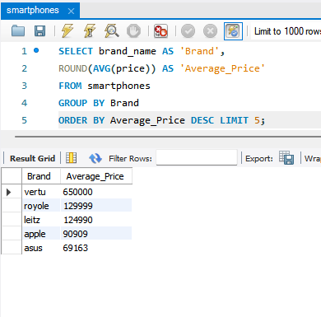
An Example of ORDER BY and GROUP BY in a problem.
** Find 5 brands with highest average price.
In the image alongside, We have successfully managed to get the cleaner data, that may be required, by using GROUP BY and ORDER BY.
Notice the Aliases, AVG, DESC and LIMIT and utilise these queries, statements or attributes to similar problems while analyzing the data.
6

Slide 8
HAVING
HAVING is a clause in MySQL that is used to filter the results of a GROUP BY query.
It allows us to specify a condition that must be satisfied by the grouped data, in order to be included in the result set.
The HAVING clause is similar to WHERE clause, but, it is used with aggregate functions such as SUM, COUNT, AVG, MAX and MIN.
This allows us to perform calculations on groups of rows in a table.
Note : HAVING clause is applied after the GROUP BY clause, so we can only refer columns that are either grouped by or aggregated in the SELECT clause.
We can also use logical operators such as AND, OR, and NOT in the HAVING clause to create more complex conditions.
7

Slide 9
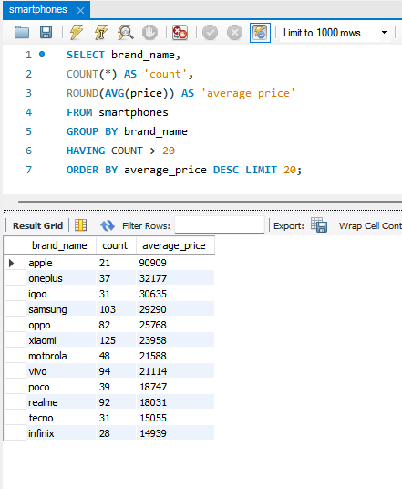
Find Average Price of smartphone brands which have more than 20 Phones
In the image alongside, We have utilised HAVING clause within GROUP BY to group the data as per the conditions needed.
We have also sorted the grouped data.
This is a good example where complete Grouping and Sorting has been used successfully to create a result set of desired data.
There can be complex conditions, but this is aimed for understanding and hence simpler.
8

Slide 10
CONCLUSION
Grouping and Sorting are two important features in MySQL that allow us to analyze and organize large amounts of data.
GROUP BY, ORDER BY, LIMIT, DESC, ASC are mostly used queries that are associated with Grouping and Sorting.
GitHub Repository
https://github.com/rahulpal-1991/Refresh-MySQL-Skills-in-7-Days
9

